Slide 1
Remote Method Invocation in Java
Unit 5
Remote Method Invocation
Bennie Lewis
EEL 6897

Slide 2
Contents
5.1 Introduction to Distributed Computing with RMI : Goals, Comparison of Distributed and Non distributed Java Programs.
5.2 Java RMI Architecture and Interfaces.
5.3 Naming Remote Objects, Using RMI, Interfaces, Implementation, Stubs and Skeletons, Host Server, Client.
5.4 Running RMI System, Parameters in RMI, Remote Object Parameters.

Slide 3
Introduction
RMI
RMI stands for Remote Method Invocation. It is a mechanism that allows an object residing in one system (JVM) to access/invoke an object running on another JVM.
The Java Remote Method Invocation (RMI) mechanism is the most important and widely used distributed object systems.
RMI is used to build distributed applications; it provides remote communication between Java programs.

Slide 4
WHAT IS RMI
RMI is a distributed object system that enables us to easily develop distributed Java applications.
It enables software developers to write distributed applications in which the methods of remote objects can be invoked from other JVMs
In RMI, the developer has the illusion of calling a local method from a local class file, when in fact the arguments are shipped to the remote target and interpreted, and the results are sent back to the callers.
RMI is a core package of the JDK 1.1 and above.
It is provided in the package java.rmi.

Slide 5
distributed application.
If any application performs following tasks, it can be distributed application.
The application need to locate the remote method
It need to provide the communication with the remote objects, and
The application need to load the class definitions for the objects.
The RMI application have all these features, so it is called the distributed application.

Slide 6
The Goals of RMI
Invocation of object methods in another Java virtual machine
Ability to pass/return Java primitives and objects
Easy to use
To minimize the complexity of the application.
To preserve type safety.
Distributed garbage collection.
Minimize the difference between working with local and remote objects.

Slide 7
Java Remote Object Invocation (RMI)
Overview of RMI
Java RMI allowes programmer to execute remote function class using the same semantics as local functions calls.
Local Machine (Client)
SampleServer remoteObject;
int s;
…
s = remoteObject.sum(1,2);
System.out.println(s);
Remote Machine (Server)
public int sum(int a,int b) {
return a + b;
}
1,2
3

Slide 8
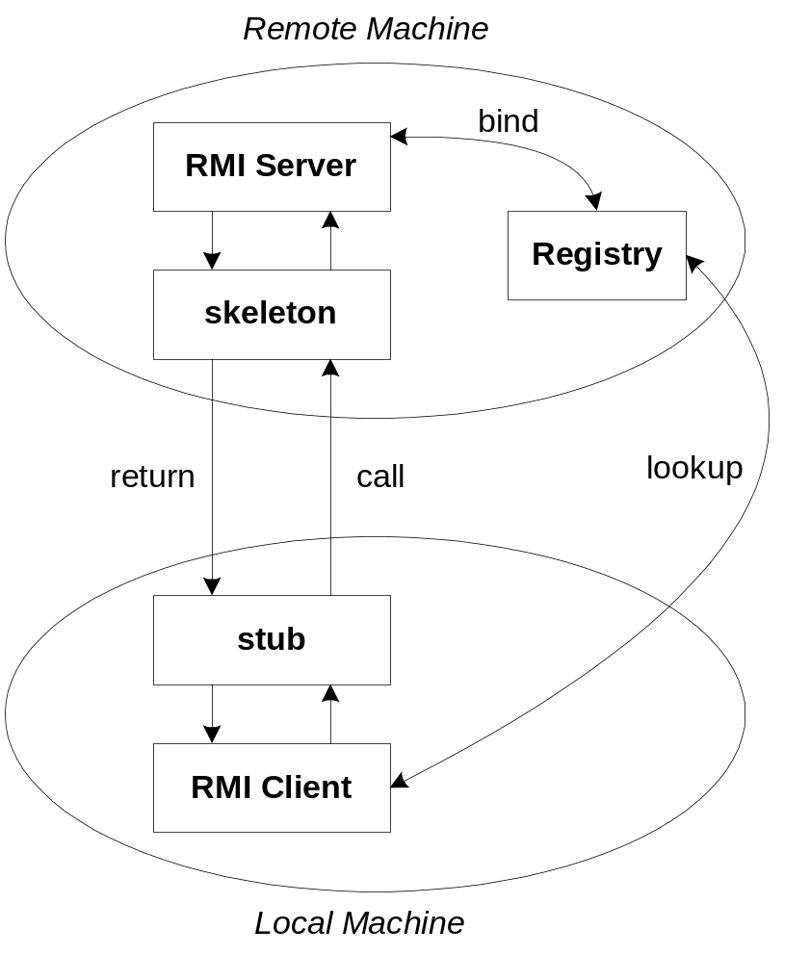
The General RMI Architecture
The server must first bind its name to the registry
The client lookup the server name in the registry to establish remote references.
The Stub serializing the parameters to skeleton, the skeleton invoking the remote method and serializing the result back to the stub.

Slide 9
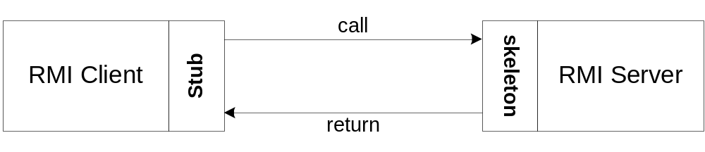
The Stub and Skeleton
A client invokes a remote method, the call is first forwarded to stub.
The stub is responsible for sending the remote call over to the server-side skeleton
The stub opening a socket to the remote server, marshaling the object parameters and forwarding the data stream to the skeleton.
A skeleton contains a method that receives the remote calls, unmarshals the parameters, and invokes the actual remote object implementation.

Slide 10
The RMI system architecture
The RMI system is built in three layers
The stub/skeleton layer
The remote reference layer
The transport layer

Slide 11
Architecture
Client
Server
Stubs
Skeletons
Remote Reference
Remote Reference
Transport

Slide 12
The stub/skeleton layer
The stub/skeleton layer is the interface between the application layer and the rest of the system.
When a server application is developed, Stubs and skeletons are generated using the RMI’ rmic compiler, which generates proxy classes from the servers bytecodes.
The stub/skeleton layer transmits data to the remote reference layer via the abstraction of marshal streams which use objects serialization.
Therefore, this layer does not deal with the specifics of any transport.

Slide 13
The remote reference layer
The remote reference layer is a middle layer between the stub/skeleton layer and the transport layer.
This layer is responsible for providing the ability to support varying remote reference or invocation protocols independent of the client stubs and server skeletons.

Slide 14
The Transport layer
The transport layer is the low-layer that ships marshal streams between different address spaces.
The transport layer is responsible for setting up connections to remote address spaces, managing connections, listening for incoming calls, maintaining a table of remote objects that reside in the same address space, setting up a connections to this dispatcher.
5

Slide 15
How RMI works
When a client invokes an object implementation from the server the three layers of RMI come in the play.
The most important layer to the programmer is the stub/skeleton layer.
RMI comes with an rmic compiler that generates stubs and skeletons from user defined remote interfaces.
Basically, stubs are client proxies and skeletons are server-side entities.
Stubs will allow clients to communicate with the other layers of the system.
This is done automatically as you will have to in inherit from RMI classes.

Slide 16
RMI Registry
RMI registry is a namespace on which all server objects are placed.
Each time the server creates an object, it registers this object with the RMI registry (using bind() or reBind() methods).
These are registered using a unique name known as bind name.
To invoke a remote object, the client needs a reference of that object. At that time, the client fetches the object from the registry using its bind name (using lookup() method).

Slide 17
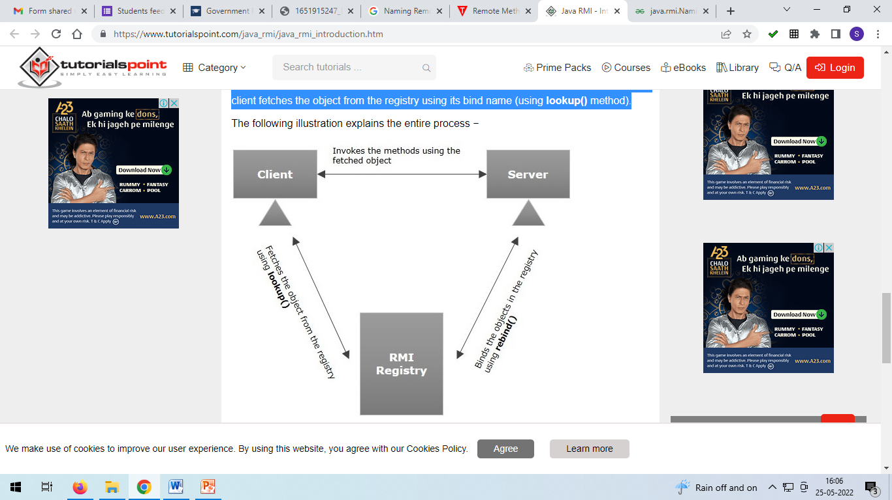

Slide 18
Naming Remote Objects
Java.rmi.Naming class contains a method to bind, unbind or rebind names with a remote object present at the remote registry.
This class is also used to get the reference of the object present at remote registries or the list of name associated with this registry.
Syntax: Class declaration
public final class Naming extends Object
The most commonly used methods are described below as follows:
bind()
list()
lookup()
rebind()
unbind()

Slide 19
Syntax:
static void bind(String name, remote object)
// Bind this name with this remote object
Parameters: Name of the remote registry
Method 2: list() Used to get the list of the names associated with the registry
Syntax:
static string[] list(String name)Parameters: The name of the remote registry
Return Type: An array of name bounded with this registry
Method 3: lookup() looks for the reference of the remote object to which this name is associated
Syntax:
static remote lookup(String name)Parameters: The name of the remote registry
Return Type: The reference for a remote object

Slide 20
rebind() method rebinds this name with the associated remote object
Syntax:
static void rebind(String name, remote object)Parameters: It takes two parameters namely name and object.
The name of the remote registry
The remote object to associate with the name.
Method 5: unbind() unbinds this name with the associated remote object
Syntax:
static void unbind(String name)
Parameters: The name of the remote registry

Slide 21
To write an RMI Java application, following steps are used −
Define the remote interface
Develop the implementation class (remote object)
Develop the server program
Develop the client program
Compile the application
Execute the application

Slide 22
Defining the Remote Interface
A remote interface specifies the methods that can be invoked remotely by a client.
Clients program communicate to remote interfaces, not to classes implementing it.
To be a remote interface, a interface must extend the Remote interface of java.rmi package.
Since there is a chance of network issues during remote calls, an exception named RemoteException may occur; throw it.
import java.rmi.Remote;
import java.rmi.RemoteException;
import java.rmi.*;
public interface AddServerInterface extends Remote {
public int sum(int a,int b);
}

Slide 23
Developing the Implementation Class (Remote Object)
We need to implement the remote interface created in the earlier step. (We can write an implementation class separately or we can directly make the server program implement this interface.)
To develop an implementation class −
Implement the interface created in the previous step.
Provide implementation to all the abstract methods of the remote interface.

Slide 24
import java.rmi.*;
import java.rmi.server.*;
public class Adder extends UnicastRemoteObject implements AddServerInterface
{
Adder()throws RemoteException{
super();
}
public int sum(int a,int b)
{
return a+b;
}
}

Slide 25
Developing the Server Program
An RMI server program should implement the remote interface or extend the implementation class.
Here, we should create a remote object and bind it to the RMIregistry.
To develop a server program −
Create a client class from where you want invoke the remote object.
Create a remote object by instantiating the implementation class as shown below.
Export the remote object using the method exportObject() of the class named UnicastRemoteObject which belongs to the package java.rmi.server.
Get the RMI registry using the getRegistry() method of the LocateRegistry class which belongs to the package java.rmi.registry.
Bind the remote object created to the registry using the bind() method of the class named Registry. To this method, pass a string representing the bind name and the object exported, as parameters.

Slide 26
import java.rmi.*;
import java.rmi.registry.*;
public class AddServer {
public static void main(String args[]) {
try {
AddServerInterface addService=new Adder();
Naming.rebind("AddService",addService); //addService object is hosted with name AddService
}
catch(Exception e) {
System.out.println(e);
}
}
}

Slide 27
import java.rmi.*;
public class Client {
public static void main(String args[]) {
try{
AddServerInterface st = (AddServerInterface)Naming.lookup("rmi://"+args[0]+"/AddService");
System.out.println(st.sum(25,8));
}
catch(Exception e) {
System.out.println(e);
}
}
}

Slide 28
import java.rmi.registry.Registry;
import java.rmi.registry.LocateRegistry;
import java.rmi.RemoteException;
import java.rmi.server.UnicastRemoteObject;
public class Server extends ImplExample {
public Server() {}
public static void main(String args[]) {
try {
// Instantiating the implementation class
ImplExample obj = new ImplExample();
// Exporting the object of implementation class
// (here we are exporting the remote object to the stub)
Hello stub = (Hello) UnicastRemoteObject.exportObject(obj, 0);
// Binding the remote object (stub) in the registry
Registry registry = LocateRegistry.getRegistry();
registry.bind("Hello", stub);
System.err.println("Server ready"); }
catch (Exception e) {
System.out.println("Server exception: " + e.toString()); e.printStackTrace(); }
} }

Slide 29
Developing the Client Program
Write a client program in it, fetch the remote object and invoke the required method using this object.
To develop a client program −
Create a client class from where your intended to invoke the remote object.
Get the RMI registry using the getRegistry() method of the LocateRegistry class which belongs to the package java.rmi.registry.
Fetch the object from the registry using the method lookup() of the class Registry which belongs to the package java.rmi.registry.
To this method, you need to pass a string value representing the bind name as a parameter. This will return you the remote object.
The lookup() returns an object of type remote, down cast it to the type Hello.
Finally invoke the required method using the obtained remote object.

Slide 30
import java.rmi.registry.LocateRegistry;
import java.rmi.registry.Registry;
public class Client {
private Client() {}
public static void main(String[] args)
{ try
{ // Getting the registry
Registry registry = LocateRegistry.getRegistry(null);
// Looking up the registry for the remote object
Hello stub = (Hello) registry.lookup("Hello");
// Calling the remote method using the obtained object
stub.printMsg();
// System.out.println("Remote method invoked"); }
catch (Exception e) {
System.err.println("Client exception: " + e.toString()); e.printStackTrace(); }
} }

Slide 31
Example
package RMI.hello;
import java.rmi.Naming;
import java.rmi.RemoteException;
import java.rmi.RMISecurityManager;
import java.rmi.server.UnicastRemoteObject;
public class RMIserver extends UnicastRemoteObject implements Hello
{
public RMIserver() throws RemoteException
  {
super();
}
public String sayHello()
{
return "Bennie Lewis Hello World!";
}
public static void main(String args[])
{
if(System.getSecurityManager() == null)
{
System.setSecurityManager(new RMISecurityManager());
}
try
{
RMIserver obj = new RMIserver();
Naming.rebind("//localhost/HelloServer",obj);
System.out.println("HelloServer bound in registry");
}
catch(Exception e)
{
System.out.println("RMIserver err: " + e.getMessage());
e.printStackTrace();
}
}
}

Slide 32
Example cont.
package RMI.hello;
import java.applet.Applet;
import java.awt.Graphics;
import java.rmi.Naming;
import java.rmi.RemoteException;
public class RMIclient extends Applet{
String message = "blank";
Hello obj = null;
public void init() {
try {
obj = (Hello)Naming.lookup("//" + getCodeBase().getHost() + "/HelloServer");
message = obj.sayHello(); }
catch(Exception e) {
System.out.println("HelloApplet exception:" + e.getMessage());
e.printStackTrace(); } }
public void paint(Graphics g) {
g.drawString(message,25,50); } }

Slide 33
Example cont.
package RMI.hello;
import java.rmi.Remote;
import java.rmi.RemoteException;
public interface Hello extends Remote
{
String sayHello() throws RemoteException;
}

Slide 34
Distributed Garbage Collection
When stand-alone applications are developed using java, objects that are no longer referenced by any client are automatically deleted. This is a desirable feature when developing distributed applications. The RMI system provides a distributed garbage collector that automatically deletes remote objects that are no longer referenced by any client.

Slide 35
Security
There are a number of security issues that you should be aware of when developing mission-critical systems in RMI.
There is no authentication; a client just requests and object (stub), and the server supplies it. Subsequent communication is assumed to b from the same client.
There is no access control to the objects
There are no security checks on the RMI registry itself; any caller Is allowed to make request.
There is no version control between the stubs and the skeletons, making it possible for client to use a down-level stub to access a more recent skeleton breaking release-to-release binary compatibility

